Slide 1
Zomato Exploratory data analysis
Final Year Project Submission
BSc-IT(2017-2020)
Submitted by
Shivangi Prasanna Koltharkar
Guided by
Dr. Preeti Gupta

Slide 2
introduction
It is not easy to look at a column of numbers or a whole spreadsheet and determine important characteristics of the data for this reason exploratory data analysis (EDA) is done, it is an approach to analyzing data sets to summarize their main characteristics, often with visual methods, like graphs, plots and tables.
As Zomato is one of the most used restaurant aggregator people more and more rely on it for ratings and more services. These ratings decide the quality of restaurant and give the customers an overall view of the services which they can have by the specific restaurant.
This increase in popularity makes it difficult to analyze the data present. If the business faces problem it will be necessary to explore the data meaningfully.

Slide 3
Need of eda
We understand the data set present with us.
Spotting missing and erroneous data.
Understanding the most important variables in the data.
To know the relationship between the variables.

Slide 4
Components of eDA
Understanding your variables
Cleaning your dataset
Analyzing relationships between variables

Slide 5
Problem definition
The project deals with exploratory data analysis in the food service industry. Report of National Restaurant Association of India (NRAI) suggests that the restaurant industry in India employs about 7.3 million people and has an estimated annual turnover of Rs. 4 Lakh Crore. The project tries to tap the very nature of this people specific industry through data analysis as it is an industry that have gained prominence over these years. Hence it makes it imperative to explore data on the basis of various aspects in food delivery, restaurant’s rating and affinity restaurant groups in the vicinity etc.
The case of Zomato is taken in particular, as it is the pioneer food aggregator.

Slide 6
Objective
In order to resolve the problem of exploratory data analysis in the food service industry, the case of Zomato has been taken up. The following objectives are to be met.
Preparation and Preprocessing of the dataset obtained from Zomato.
Data visualization through graphs and plots to explore data under the following criteria:
Online delivery services and its impact on the rating of the restaurant.
Restaurant Ratings.
Identifying correlation/affinity between the restaurants etc.

Slide 7
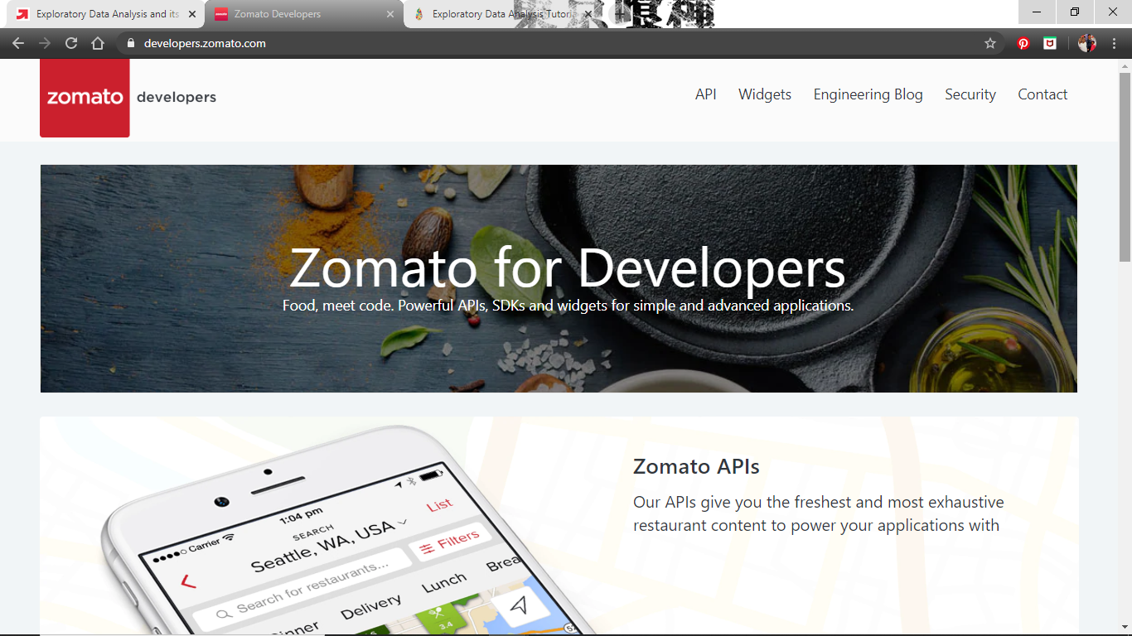
dataset
Here we have taken the dataset from Kaggle.com. As several other students around India have performed different projects using this. Which is taken from the Zomato developer website, where Zomato provides us with an API key which can be used to extract the datasets, which are present fragmented.

Slide 8
Anaconda
Anaconda is one of the most popular python distribution platform. The distribution comes with the Python interpreter and various packages related to machine learning and data science.
With conda-install command, thousand of packages can be installed for Conda, R and python.
Can build and train machine learning models using the best Python packages built by the open-source community, including scikit-learn, TensorFlow, etc.
Anaconda Navigator is a desktop GUI that comes with Anaconda Individual Edition. It makes it easy to launch applications and manage packages and environments without using command-line commands.

Slide 9
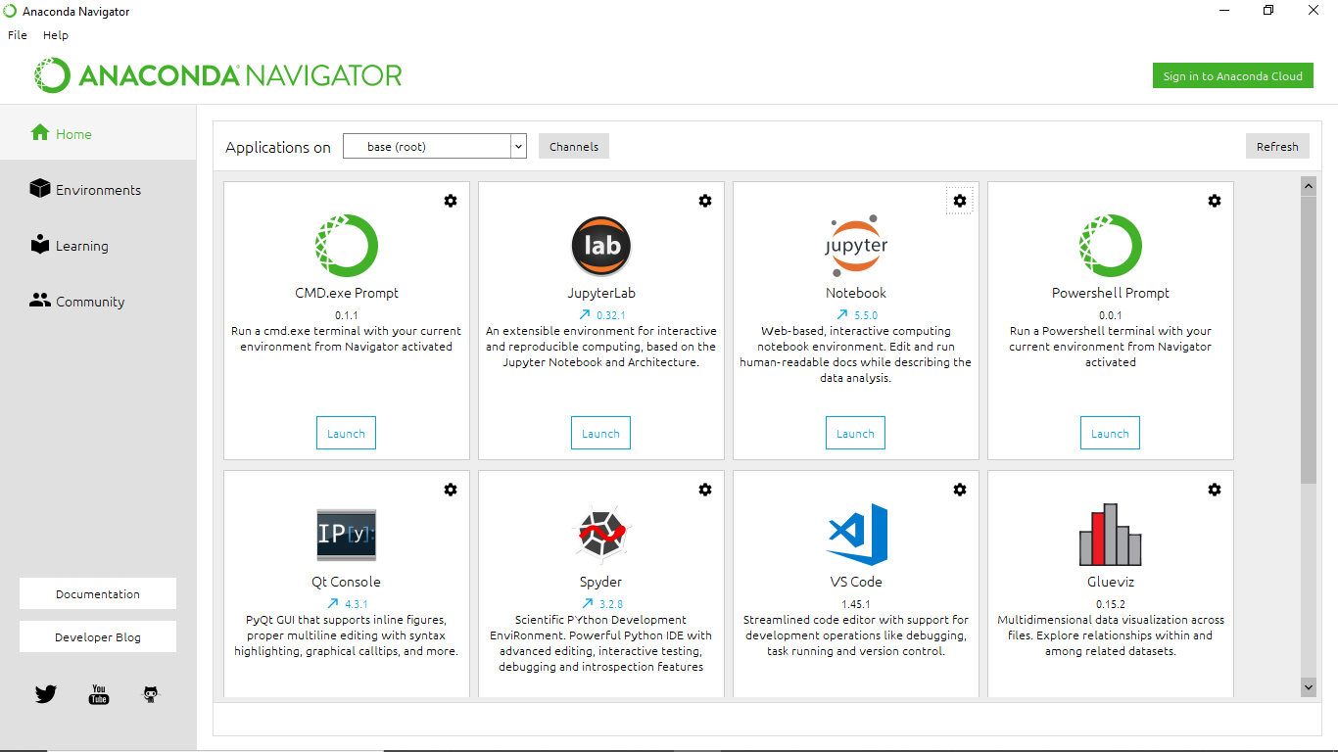

Slide 10
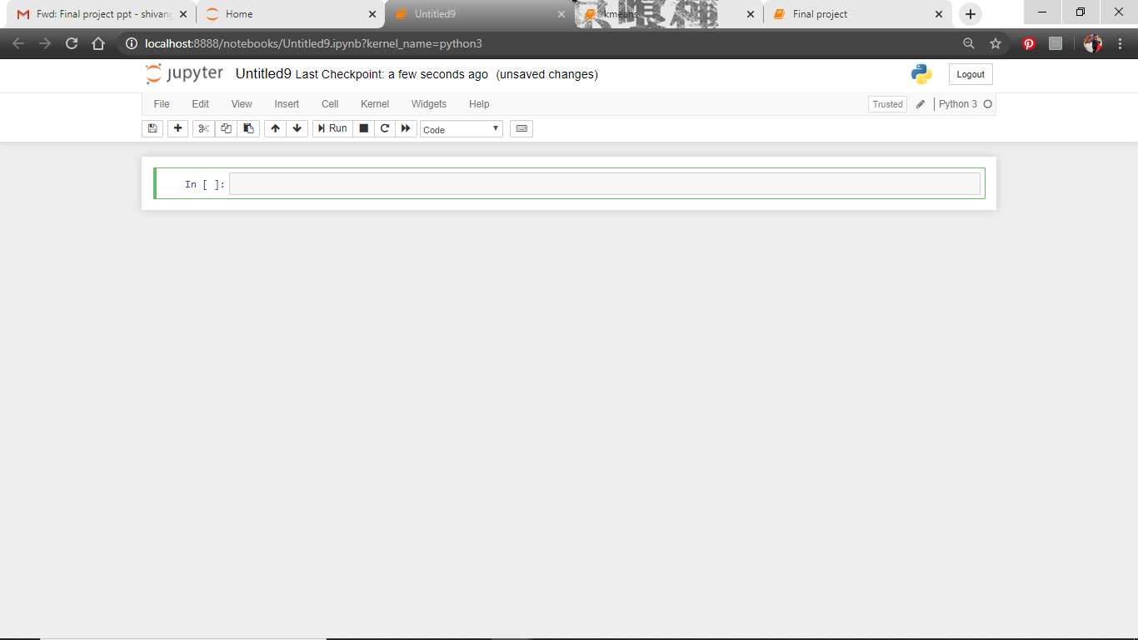
Jupyter notebook
Jupyter is an open source web application that allows you to create and share documents that contain live code, equations, visualizations and narrative text.
Uses include: data cleaning and transformation, numerical simulation, statistical modeling, data visualization, machine learning, and much more.

Slide 11
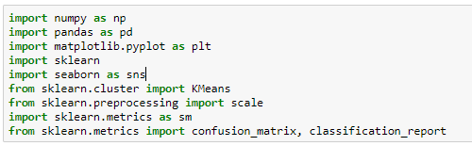
libraries
NumPy
It is a library which is used for working with arrays. It is easier to access information from NumPy than in list due to its location storage method.
Panda
It is a popular Python-based data analysis toolkit. It presents a diverse range of utilities, ranging from parsing multiple file formats to converting an entire data table into a NumPy matrix array.

Slide 12
Matplotlib.pyplot
It is a collection where all command style functions are present. It is used to create plots and figures. Where it receives data and plots graphs and figures accordingly.
Sklearn
It is a library where algorithms like support vector, random forest, k N and many more supervised and unsupervised algorithms are featured. This library is built upon scientific python SciPy.
Seaborn
This library is to create plots with more interactive figures. It is a data visualization library based on matplotlib. By using this we can create and look into complex data by great visualization. We will have to install it by using pip or conda.

Slide 13
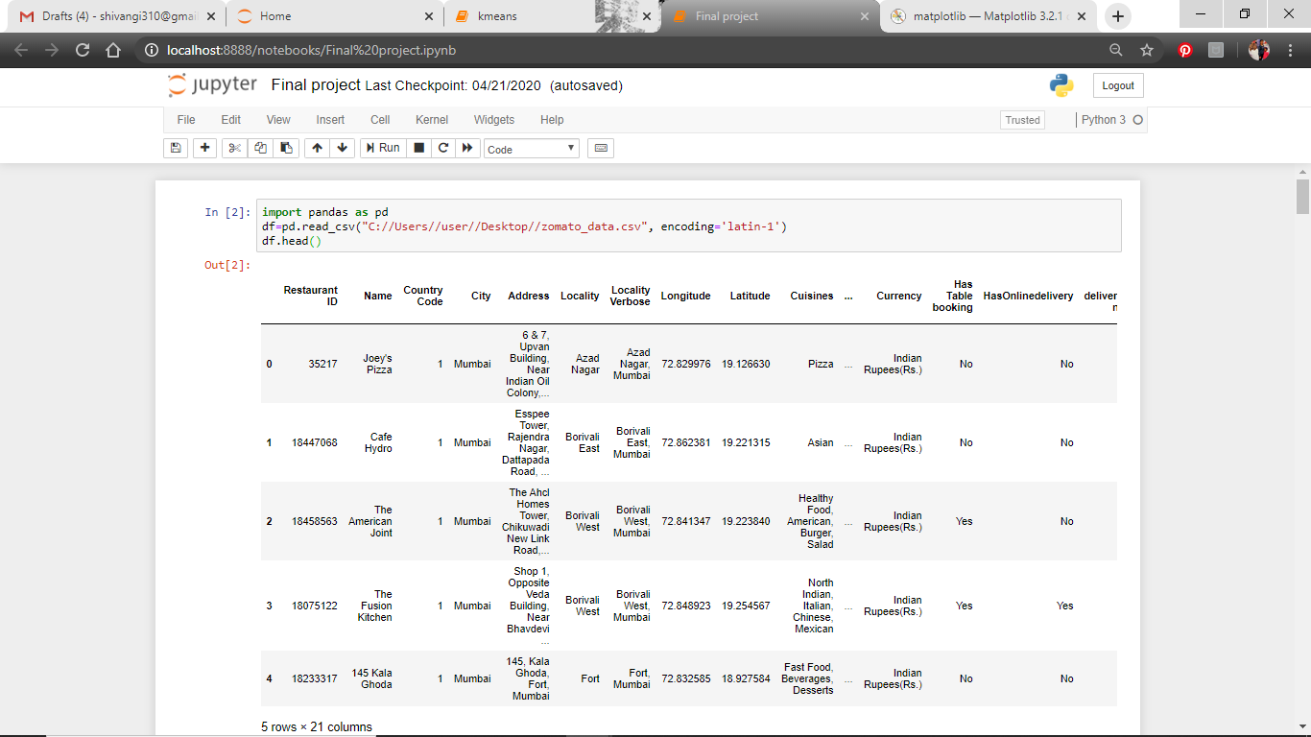
reading dataset

Slide 14
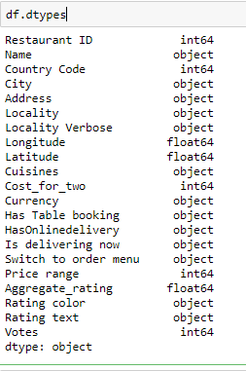
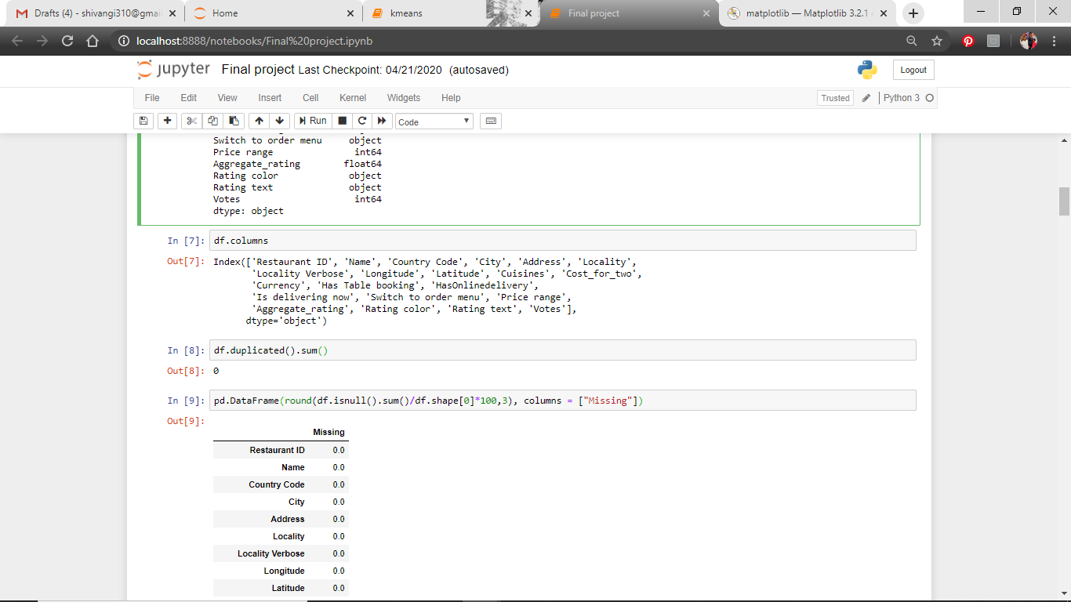
Getting to know the data
We find out the data types of each variable and column names

Slide 15
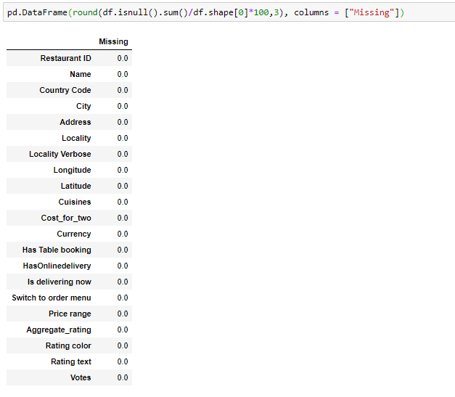
Seeing if any duplication or missing data

Slide 16
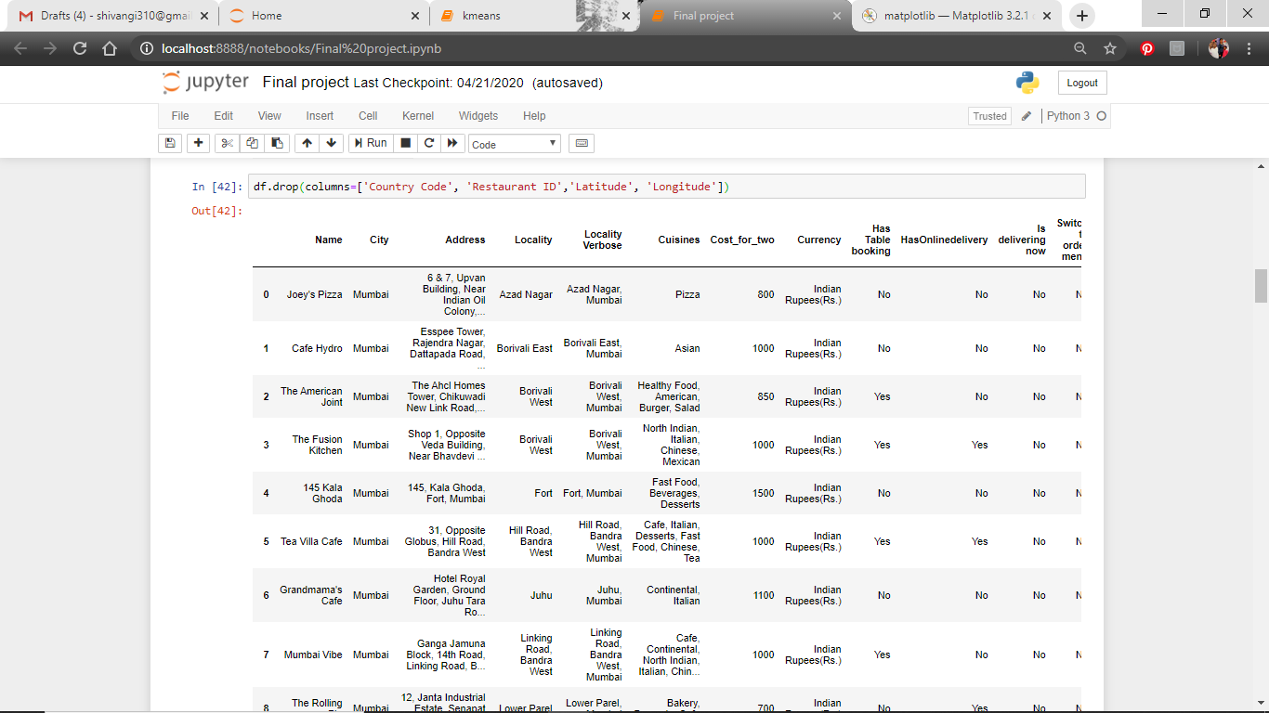
Dropping columns

Slide 17
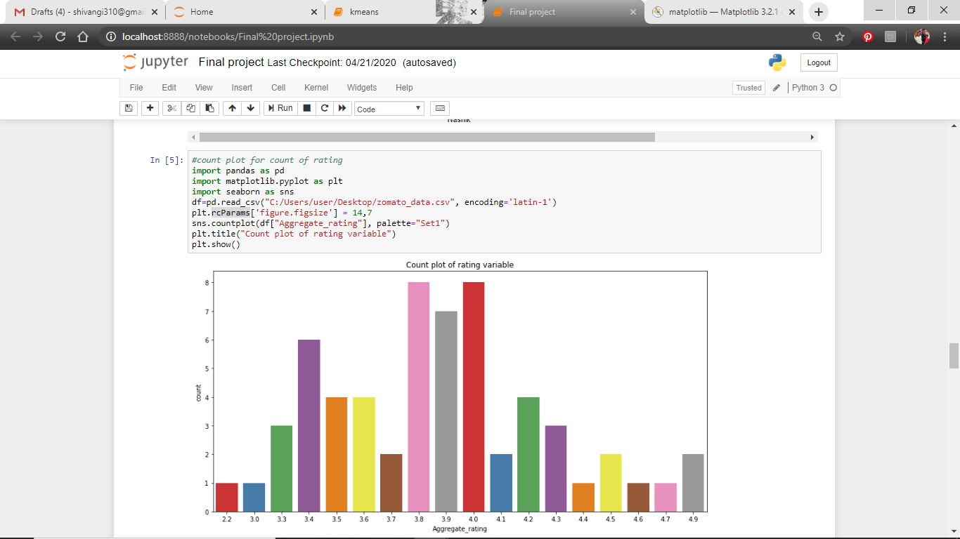
Count plot for rating
Count plot shows us the count of the observations in the given attributes.
Here we see how many restaurants have got a particular rate in their rating.

Slide 18
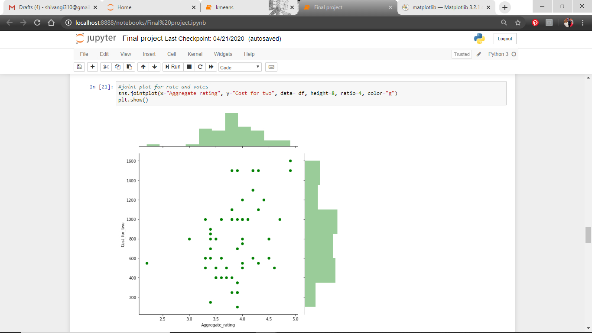
Joint plot for rates and cost for two
In Joint plot two plots are drawn simultaneously which are scatter plot and marginal histogram. A scatter plot is a diagram where each value is represented with a dot. A histogram shows frequency between x-axis and y-axis.
By this we understand that there are more ratings between 3.5 and 4.0 along the x axis and mostly costing between 800 to 1000 along the y axis.

Slide 19
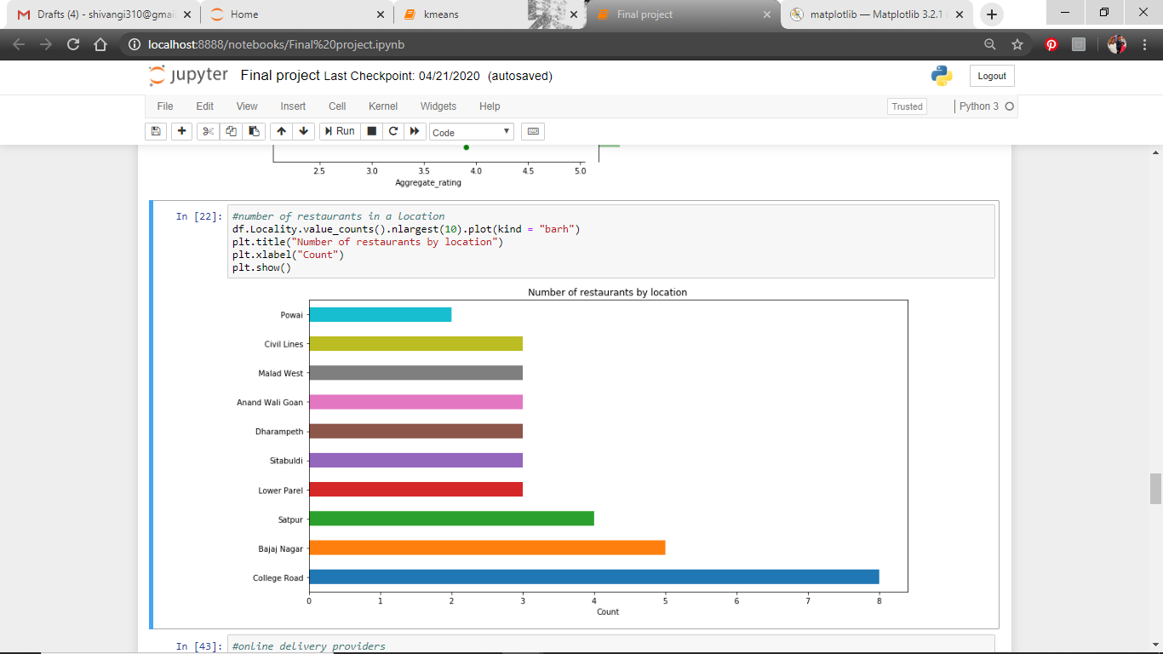
Number of restaurants in a location
This plot shows us how many restaurants are present in a specific location.

Slide 20
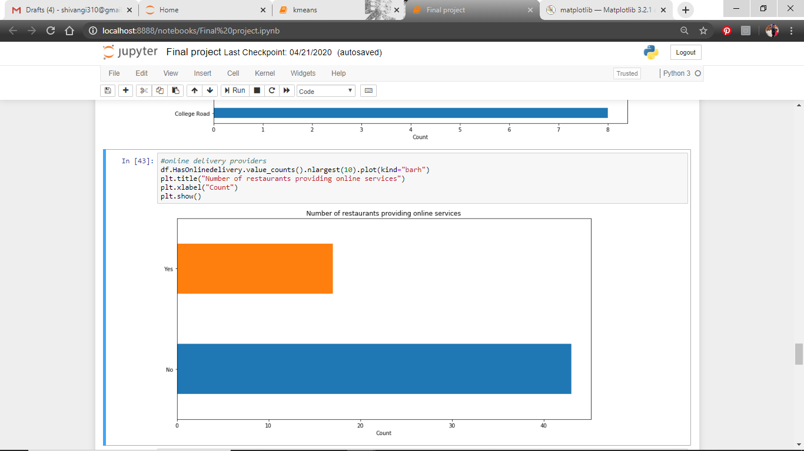
Online delivery providers
This show us how many restaurants provide online delivery and how many do not.

Slide 21
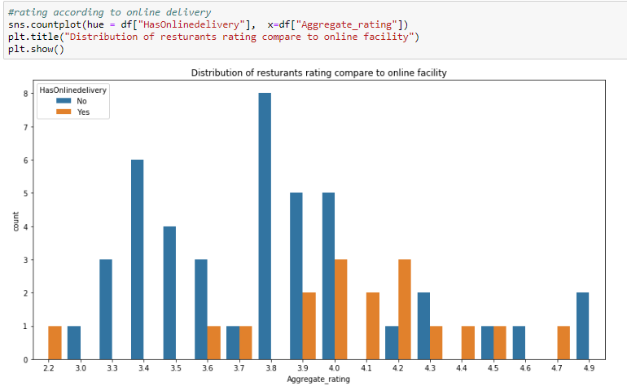
Rating according to online delivery
Here we see if the ratings are affected due to the delivery facility or not. As wee see even the restaurants that do not have online delivery have got good ratings.

Slide 22
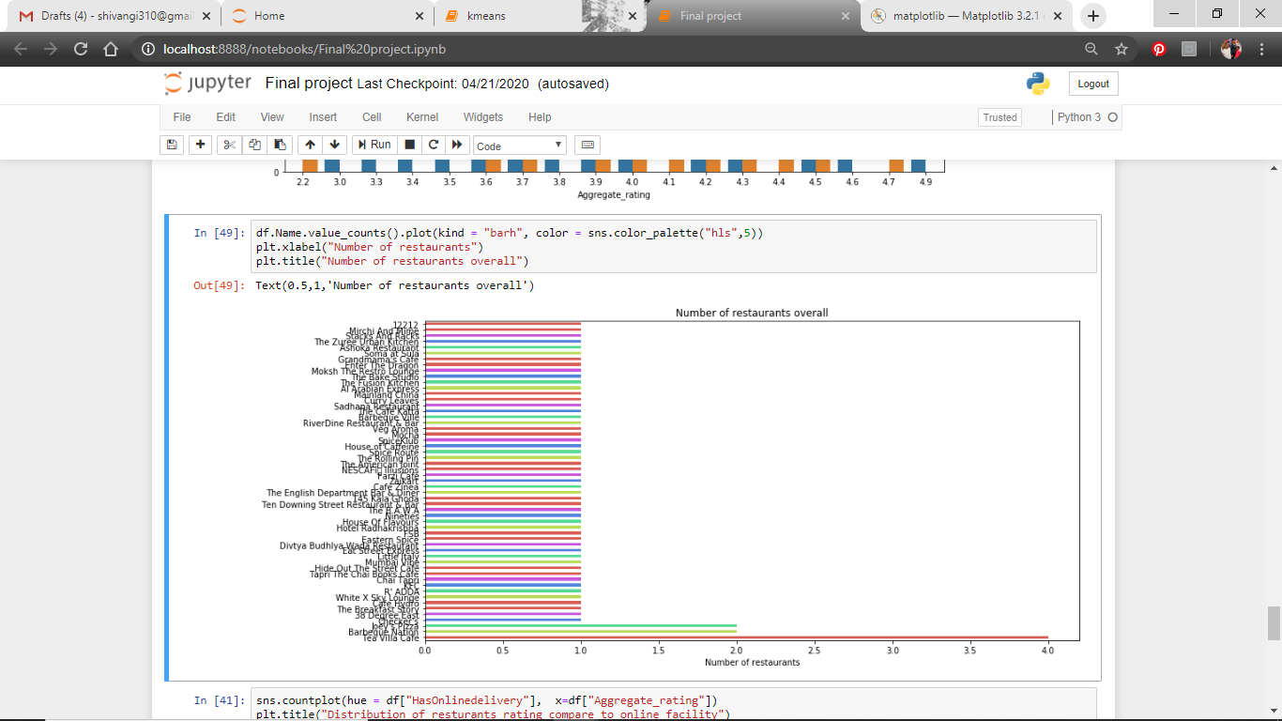
Number of restaurants overall

Slide 23
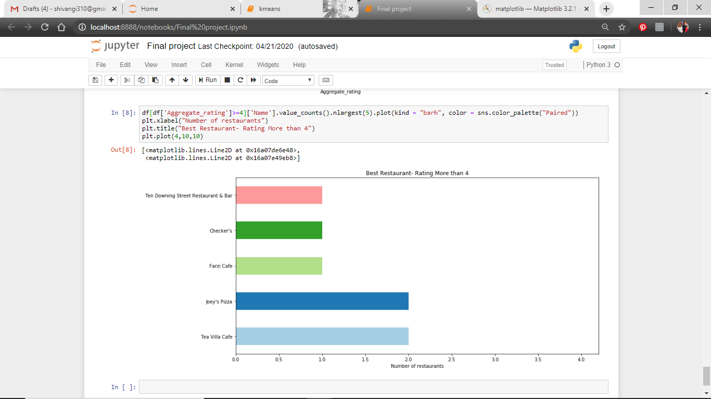
Best restaurants

Slide 24
Kmeans clustering
K-means clustering is a type of unsupervised learning, which is used when you have unlabeled data.
The goal of this algorithm is to find groups in the data, with the number of groups represented by the variable K.
The algorithm works iteratively to assign each data point to one of K groups based on the features that are provided.
Data points are clustered based on feature similarity.
The algorithms starts with initial estimates for the Κ centroids, which can either be randomly generated or randomly selected from the data set.

Slide 25
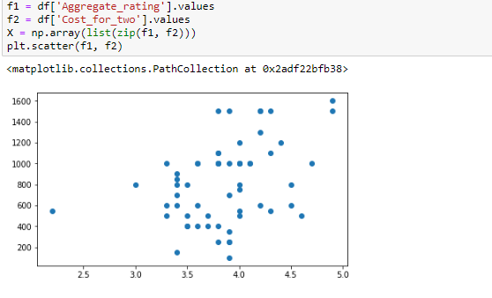
Scatter plot
We plot a scatter plot with the variables available.

Slide 26
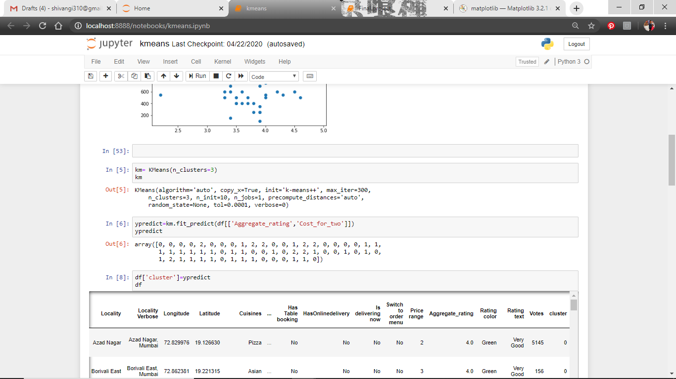
Number of clusters and grouping
Here we decide the number of cluster we want to be formed and then the values are grouped accordingly if they belong to cluster 0, 1 or 2.

Slide 27
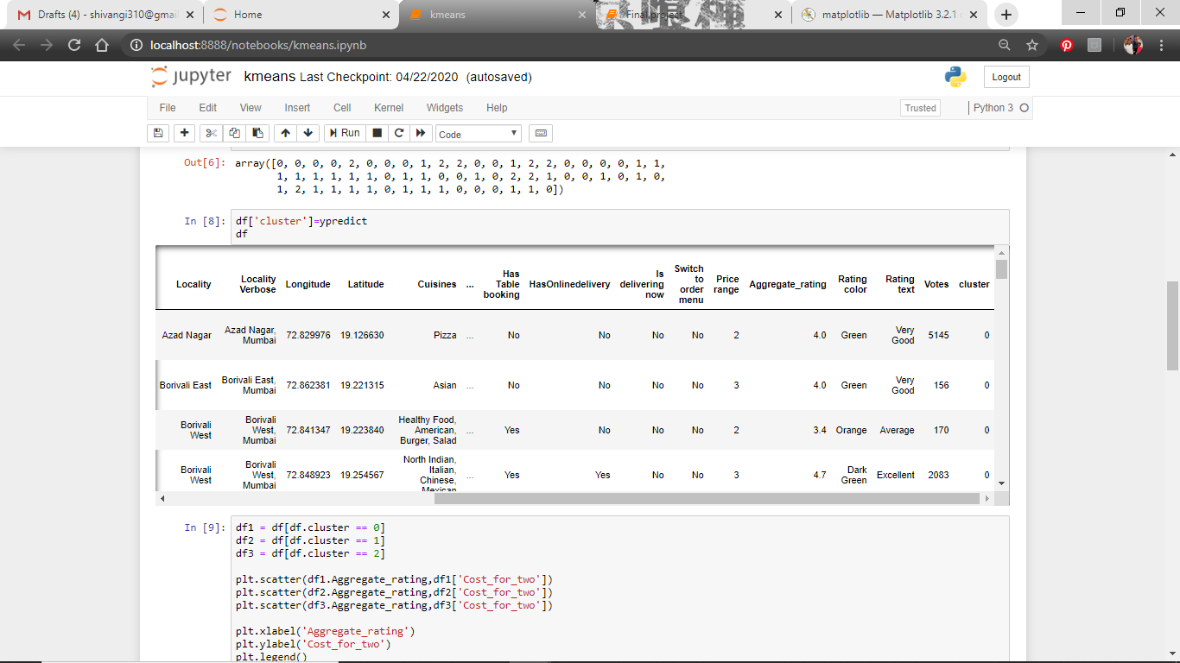
Clusters in table

Slide 28
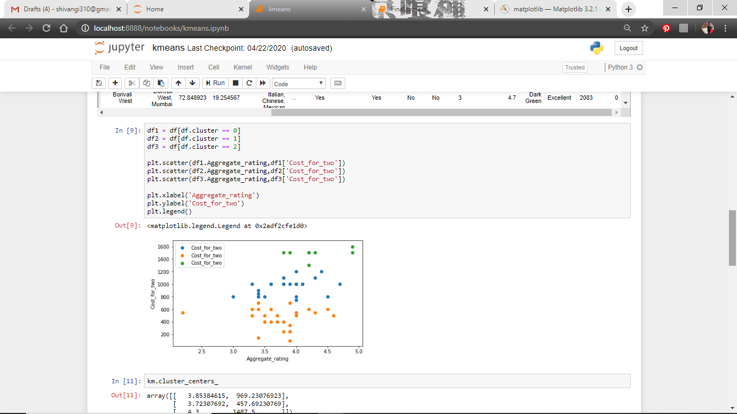
Differentiating the clusters

Slide 29
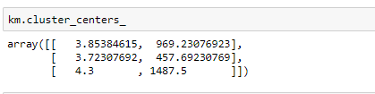
centroids
The middle of a cluster is known as a centroid it is a vector that contains one number for each variable, where each number is the mean of a variable for the observations in that cluster.

Slide 30
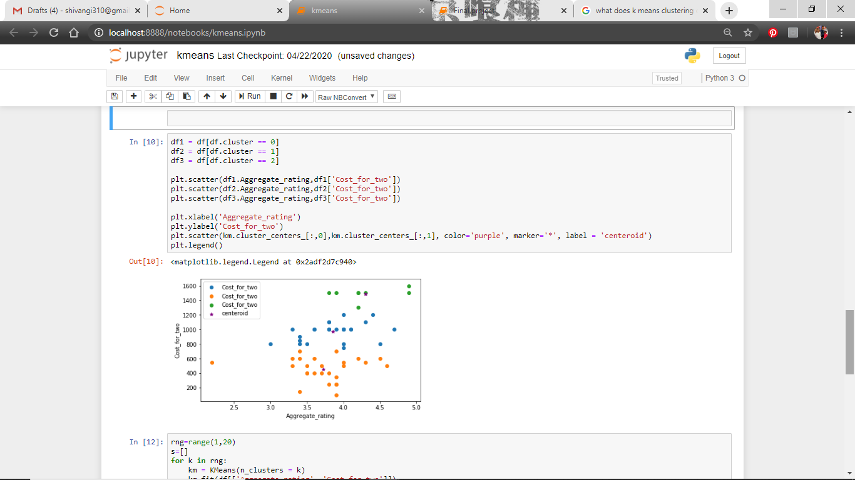
Marking the centroids

Slide 31
Elbow graph
Elbow plot method involves running the algorithm multiple times over a loop, with an increasing number of cluster choice and then plotting a clustering score as a function of the number of clusters.
The point of inflection or known as the elbow is the indication that the underlying model fits best at that point.

Slide 32
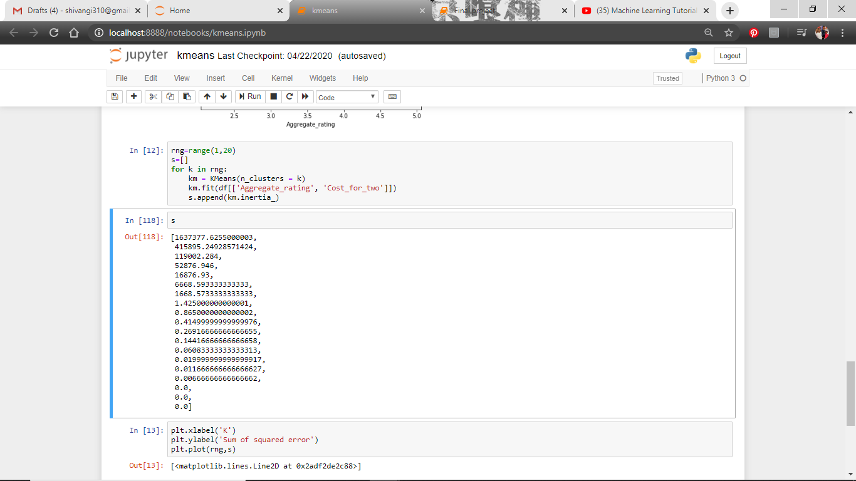
Performing iterative algorithm for elbow plot

Slide 33
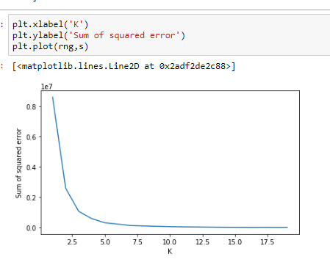
Elbow plot

Slide 34
Individual contribution
Preprocessing the data- Data type, Column names, dropping column, searching for duplication, missing data and finding the anomalies.
Implementation of Kmeans algorithm
Data Visualization- Joint plot which consist scatter plot and histogram

Slide 35
Conclusion
As we can see from the analysis done that is it not necessary to have online delivery, the restaurants still got good rating without considering that factor. What is important is the quality of the food and the consistency, that is the reason customers return. The restaurants which cost 800-1000 for two tend to get good ratings as that is the optimal money anyone would like to spend at a time.
If the restaurant can start online services it will eventually will be getting rating from both ways. There will be no major issue with their financial income and people seeing the rating will visit and enjoy the hospitability provided by the restaurant until then.

Slide 36
Bibliography
https://en.wikipedia.org/wiki/Zomato
https://www.cnbctv18.com/retail/food-for-thought-survival-of-the-restaurant-industry-in-the-times-and-post-corona-5814141.htm, May 01 2020 08:01AM IST
https://www.indiatoday.in/india/story/customers-duped-zomato-call-centre-fake-customer-care-numbers-google-search-1580678-2019-08-14
https://rstudio-pubs-static.s3.amazonaws.com/468509_51f0e06901204a0db7fabcf857719883.html
https://www.kaggle.com/himanshupoddar/zomato-bangalore-restaurants
https://www.upgrad.com/blog/exploratory-data-analysis-and-its-importance-to-your-business/
https://www.kaggle.com/shrutimehta/zomato-restaurants-data
https://seaborn.pydata.org/generated/seaborn.jointplot.html
https://www.kaggle.com/bharathsangavi/zomato-exploratory-data-analysis
https://towardsdatascience.com/understanding-k-means-clustering-in-machine-learning-6a6e67336aa1
https://www.anaconda.com/

Slide 37
thankyou

